Slide 1

Team 55: National Firefighter Registry
In Collaboration with CDC-NIOSH
11/29/2020

Slide 2
Agenda
Project Goals and Requirements
Team Roles and Contributions
Research on Design
Demonstration
Project Status and Gantt Chart
Future Plans and Opportunities

Slide 3
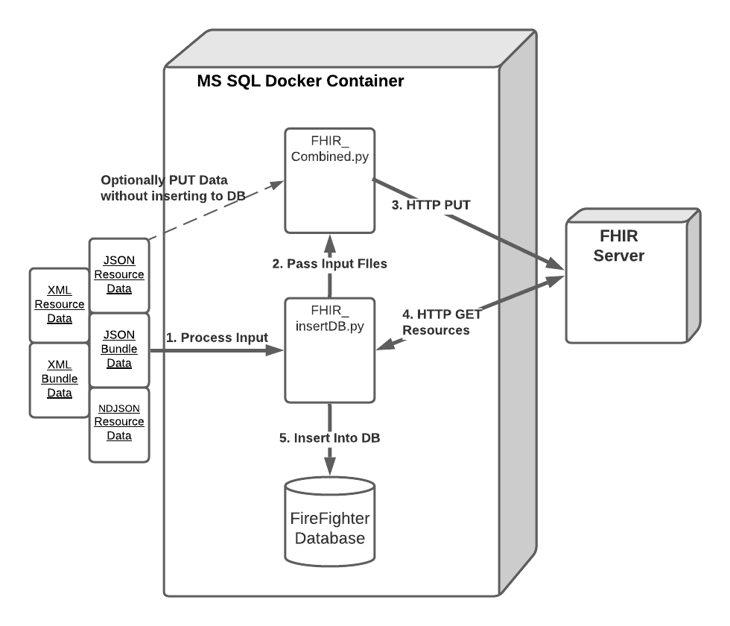

Project Goals and Requirements
Notes:
Background:
Firefighters at a higher risk of cancer than general population
Project spurred by passing of Firefighter Cancer Registry Act of 2018
Early stages of CDC’s NFR project

Slide 4
Team Roles and Contributions
Team 55 Members:
James Davis
Haolong Yan
Rahul Nowlakha
Joe Kurokawa
Traver Clifford
Eric Mammoser
CDC Mentors:
Jill Raudabaugh
Breanna Newton
GT Mentor:
Elizabeth Shivers
Notes:
Make sure to mention roles per person:
PM for James
Dev for Jan
Dev for Rahul
Dev for Joe
Dev for Traver
QA for Eric
PM responsible for putting together deliverables, organizing and running meetings (internal and external), and Tableau dashboard
Dev responsible for architecture of design as well as implementation of features
QA responsible for developing and implementing test plan to ensure functionality of the design meets the specification

Slide 5

Research on Design
Python libs:
Considered fhirclient.py to handle interaction with FHIR server
Didn’t support XML data => settled on handling own HTTP request
FHIR server to use
Public
Support R4
Mapping FHIR resources to DB fields
Worked through HL7 FHIR standard and made tentative mapping; aligned with mentor
Notes:
Mention that our research on scope & functionality was limited because this was provided by our CDC mentor
Therefore, focus is on architecture as well as implementation details such as libs to use and how to map the DB fields provided by mentor with FHIR resources

Slide 6
Project Status and Gantt Chart
Notes:
All tasks completed
Project went according to our plan with two modifications:
We refactored the FHIR validation task on older versions of the Gantt chart to be part of the parsers since we are using the FHIR server to validate and convert to a common data format (JSON)
We had a one week slip on the JSON parser because we increased the scope of the project to add support for NDJSON which is used in bulk fhir data transfer

Slide 7
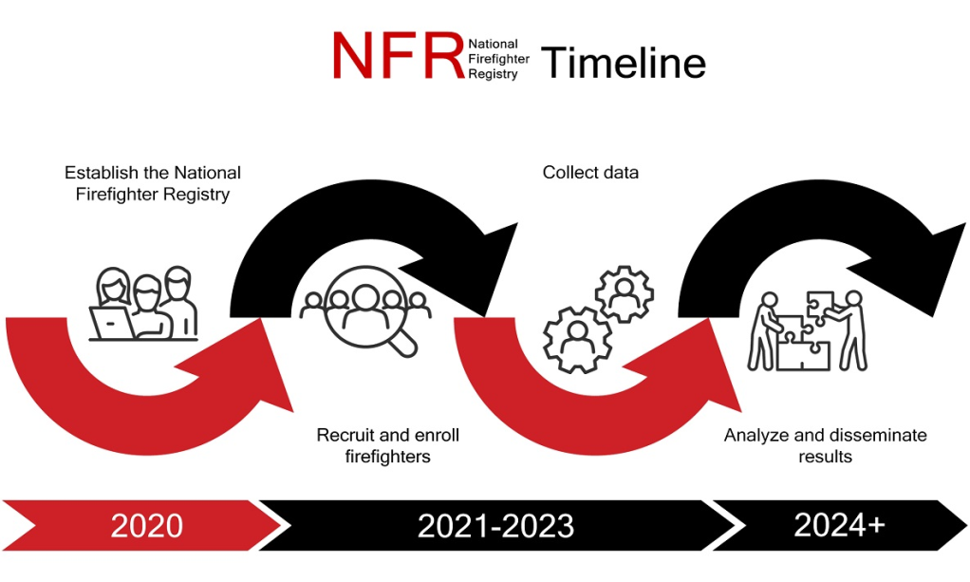
Future Plans and Opportunities
CDC to use our findings to help inform their design
Source: https://www.cdc.gov/niosh/firefighters/registry.html
Notes:
Can mention here that CDC is in the early stages of the project (e.g. 2020 still building NFR; have not yet implemented it). They will take lessons learned and the design decisions we made and use those to inform them. Next year they will begin the next phase of enrolling firefighters into the registry and, once sufficient firefighters are enrolled (both in terms of # of firefighters (looking for >200k) and representative of different types of firefighters (urban, woodlands, volunteer, etc.) as well as females/minorities), can use the data to conduct long-term studies on cancer

